Slide 1
SAFINEST
THEME - FINTRACK
Team Cyduck:
Ankit Kumar Verma Daksh Dudeja
Sourav Jha
Amrita Pandey

Slide 2
Problem Statement
According to a survey only 24% of the population are equipped with proper financial knowledge, this results in financial loss and Fraud.
There is a lack in availability of all in one financial solution, where we can learn & invest, along with tracking our expenses to analyze it for better use, also where we can get advice and assistance related to investment and tax from expert in financial fields i.e financial advisor/assistance for each and every individual at low consultation charges.
We tried to tackle this with SAFINEST (Safe & Invest).

Slide 3
Our Solution
Safinest a platform with these features:-
Personal & family expense track/manage system (add & monitor daily expenses, visualize through different graphs, set limits over your expense)
Consult Section wherein you Interact, Chat and can schedule a appointment with Financial Experts to analyze your previous transactions.
Learning section wherein you can get crisp info about Financial crimes, stocks, real estate from financial experts.
Live News, updates and Suggestions on finance/business news every hour on Safinest.
Personalized tax calculator, EMI calculator, loan calculator (FY-20-21)
Live Stock Market Prediction Tool (Customer knowledge (KYC), which involves due diligence and adequate customer profiles, such as verifying the origin of funds)

Slide 4
Frameworks and Tools
MACHINE LEARNING ALGORITHM
EXPLORATORY DATA ANALYSIS (EDA)
REACT
NODE JS
RAZORPAY
DJANGO
SOCKET IO
HEROKU
Git/GITHUB

Slide 5
Future Scope
To include Freelancers as accountants/advisors on platform to make financial assistance more feasible and accessible to all.
To Add New Tools such as Fraud detection, AI suggestions Over Expense Control, Decentralised Blockchain System Expense Tracking For Family/Group/Organization.
To Provide New Visualization Techniques To Enhance Expense Tracking

Slide 6
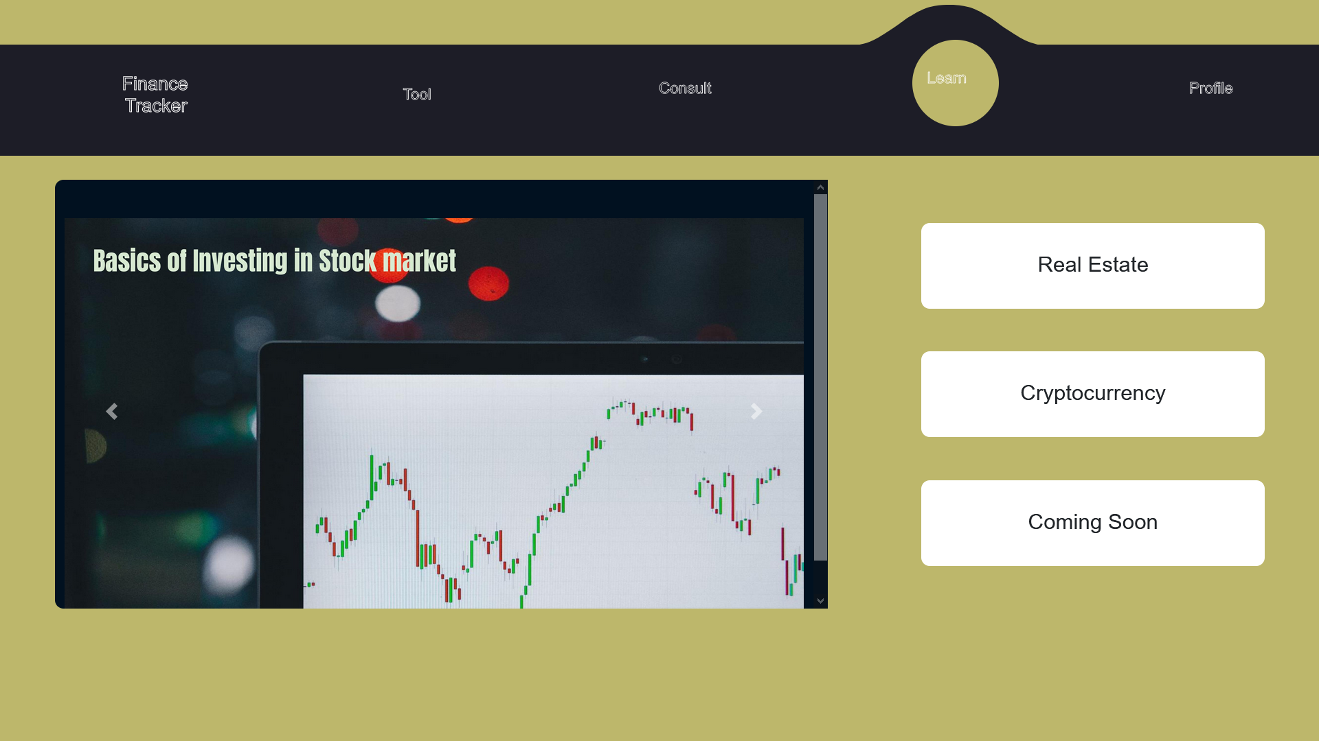

Slide 7
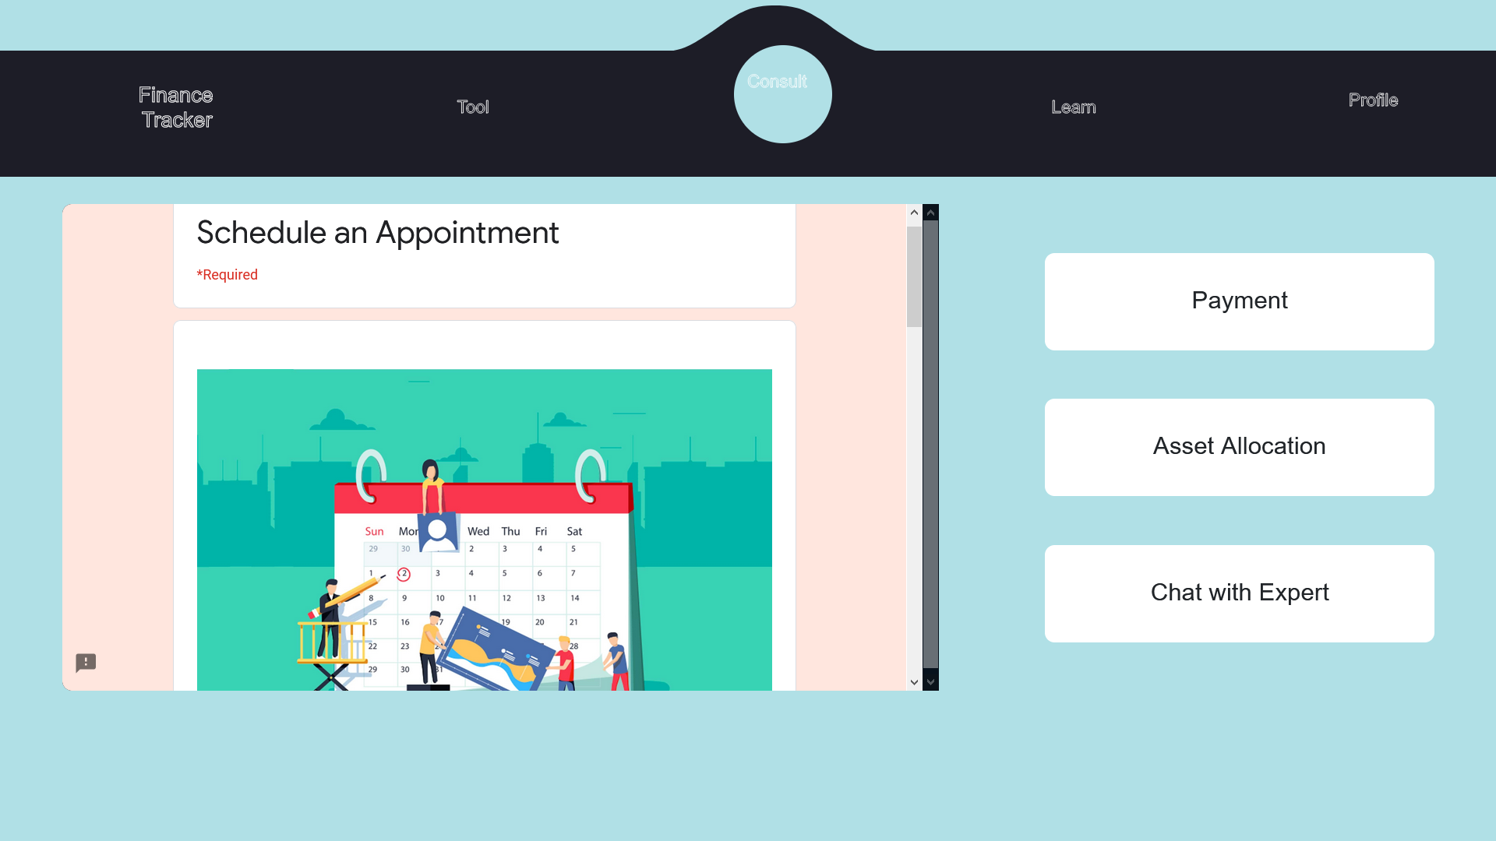

Slide 8
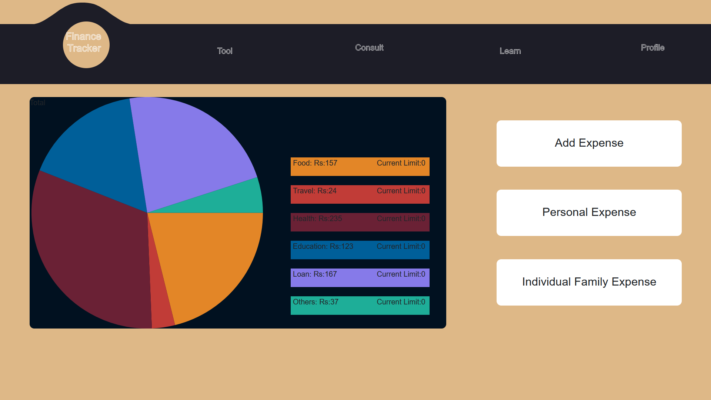

Slide 9
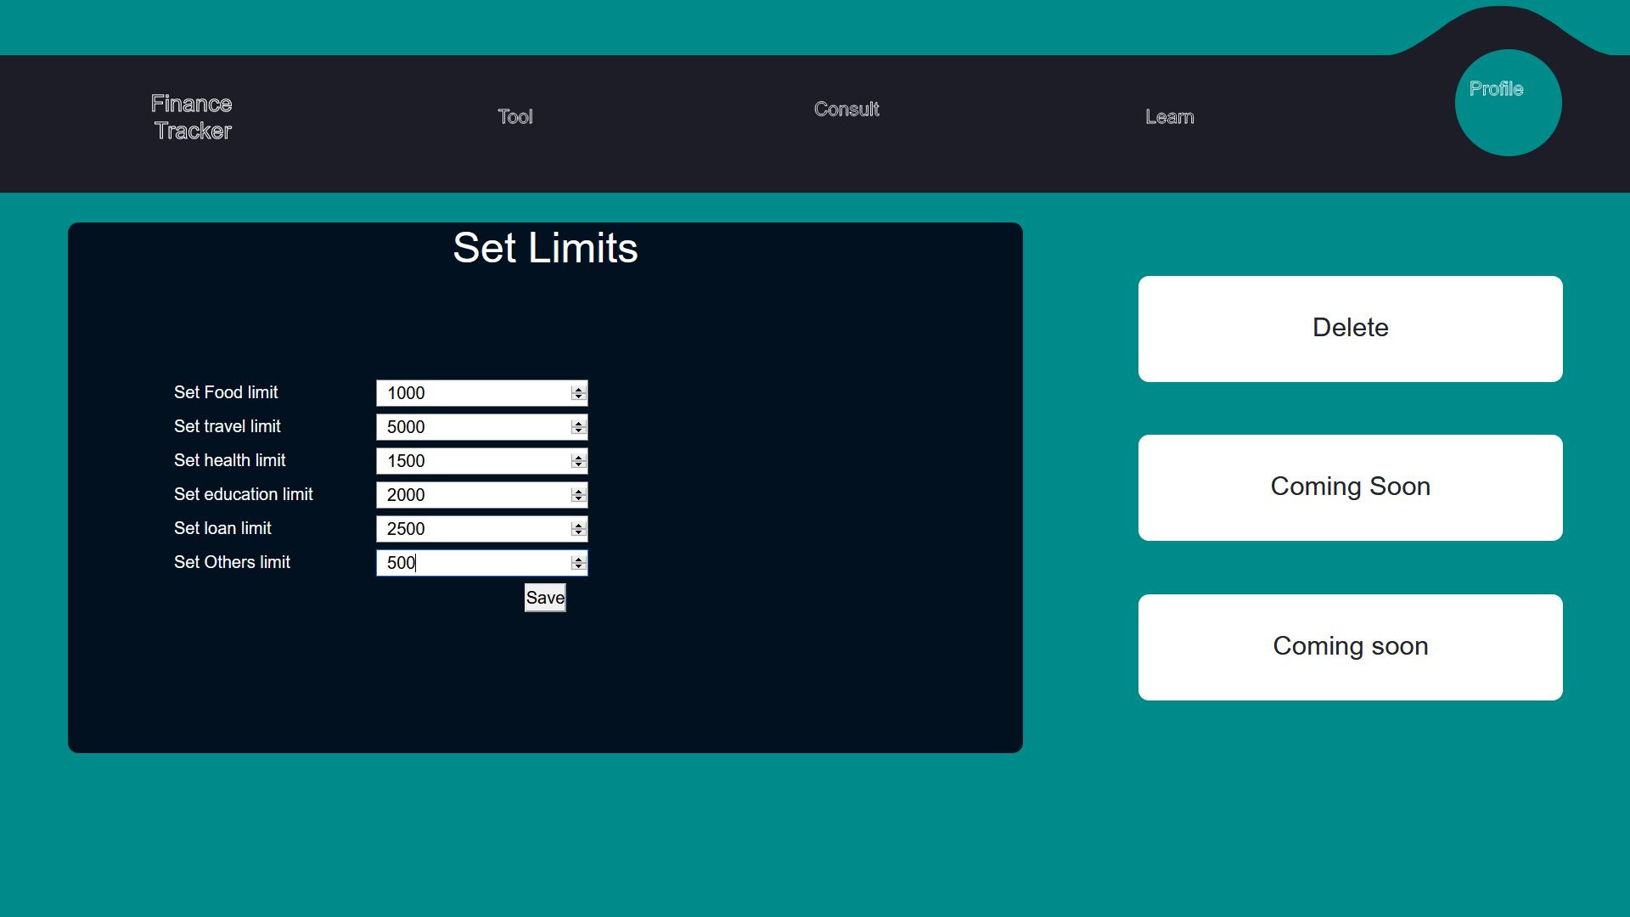

Slide 10
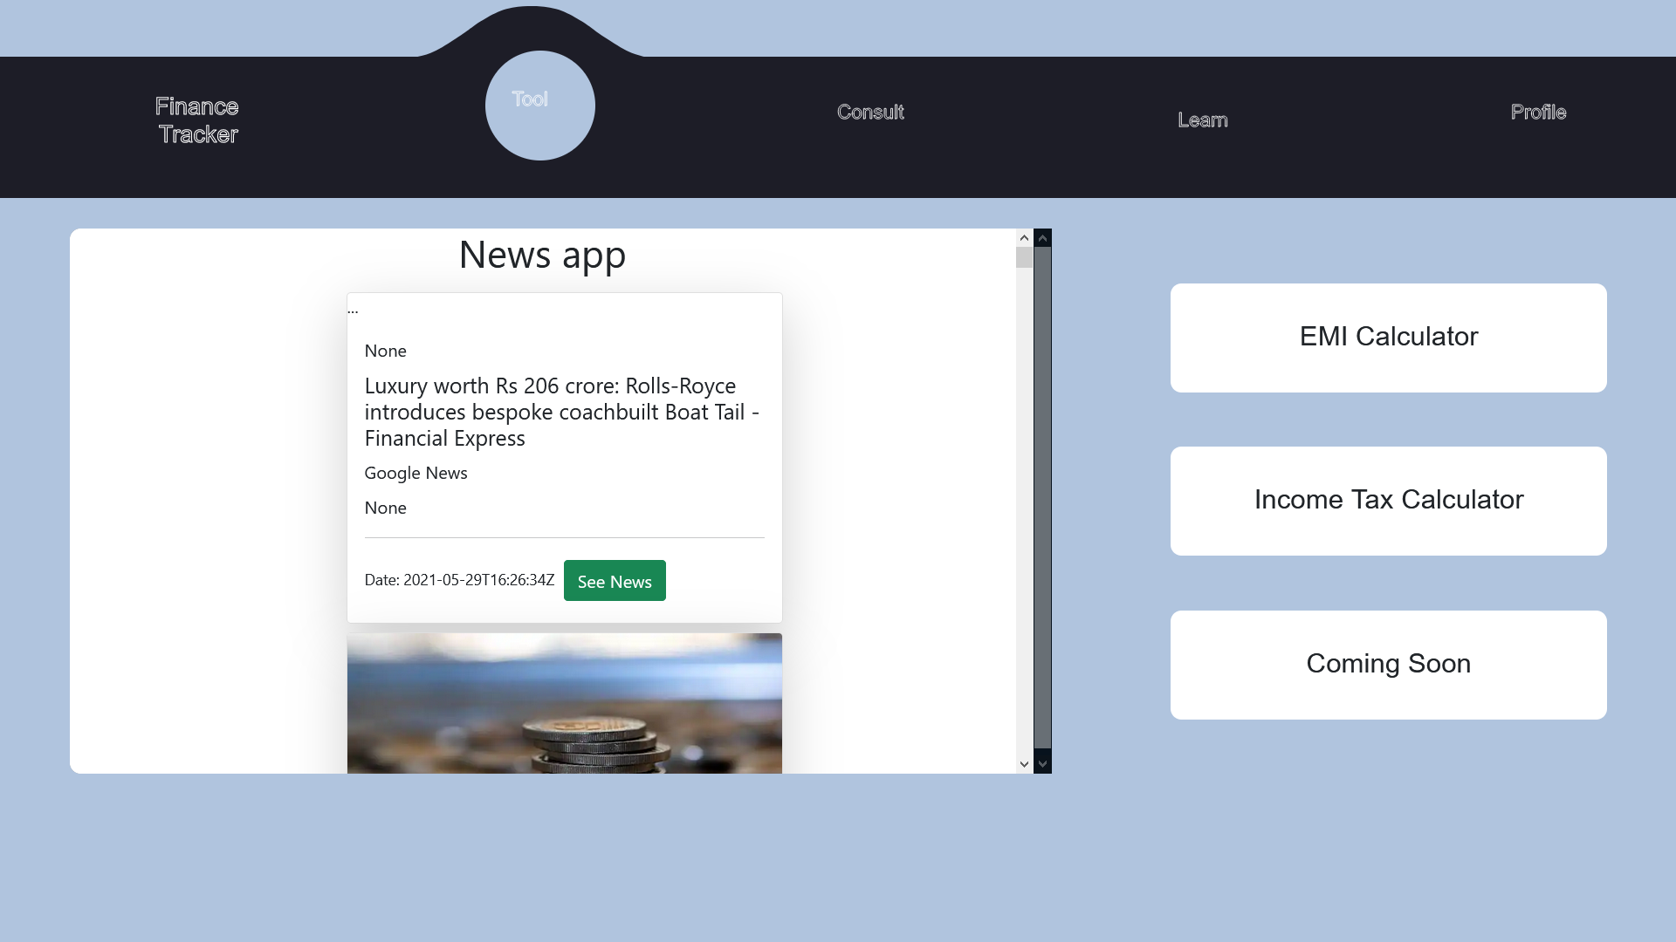

Slide 11
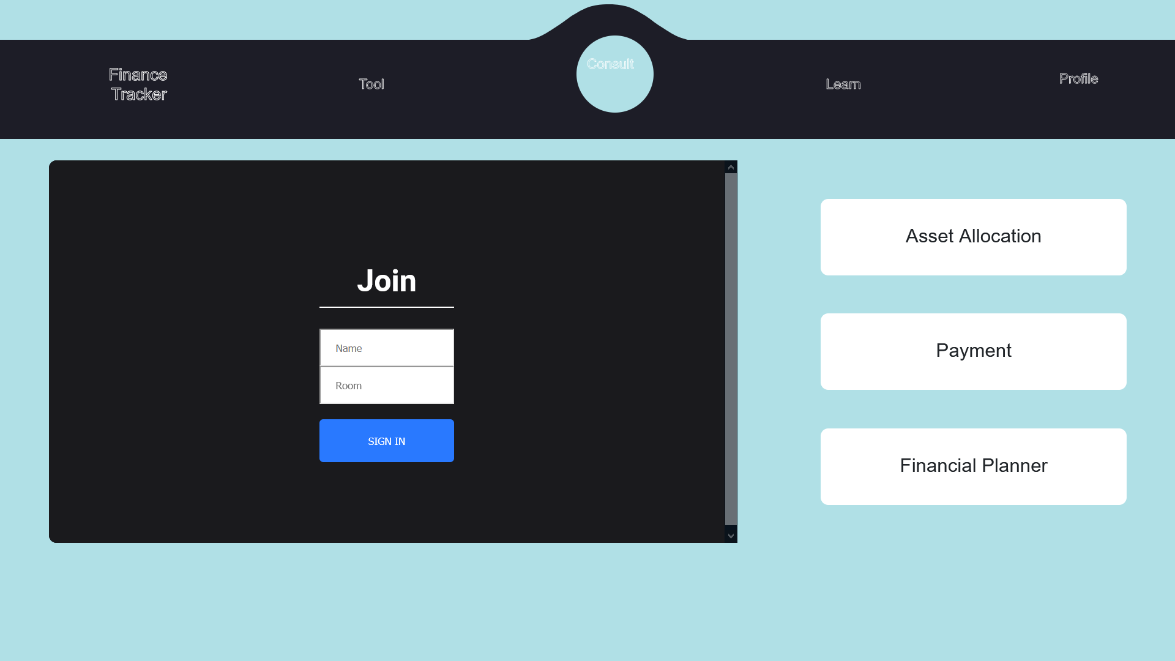

Slide 12
